Slide 1

Medical Transcriptionist Diploma Program + Internship
Welcome to triOS College

Slide 2

Welcome
Welcome to triOS College!
Medical Transcriptionist Resource Guide and Support Services
Wishing you success as you take this step in pursuing your dreams!

Slide 3
Introduction
My name is Lori Mann and I will be your Medical Transcriptionist Program Facilitator.
As the Facilitator, I will monitor your progress on a daily/weekly basis and provide grades and updates to your Campus Director and Program Administrator. I will also be available to answer any questions you may have, as well as provide guidance to you throughout your program. I will be available during class hours: Monday to Friday, 8:00 AM to 1:00 PM.
You should have already received all of the materials you will need to succeed in the program, including the Medical Transcriptionist Diploma Program Resource Guide – a very informative and useful tool. Included in the Resource Guide is the Medical Transcriptionist Diploma Program Learning Guide – an outline of what should be completed each day in order to stay on track and complete the program on time. I recommend that you check off each section as it is completed, to ensure that you stay on track!

Slide 4
Introduction
Attendance is mandatory; this is explained in detail in the Medical Transcriptionist Resource Guide, as well as your Student Handbook.
For any concerns regarding the on-site campus itself, please connect with the staff or the Campus Director directly.
Good Luck and Welcome to triOS College and the Medical Transcriptionist Diploma Program!

Slide 5
Being a triOS Student
You should have received the triOS College Student Handbook, which will help you to become familiar with the College and your campus.
Please be aware that attendance is mandatory and you will be required to sign in before class starts each morning (8:00 AM) and sign out when class finishes (1:00 PM) at the reception desk.
Attendance will be recorded by your Program Administrator and monitored by the Facilitator. If you are unable to attend class for a day, you are required to phone in to the front desk at your campus before class starts that day as well as email the Facilitator.
As an Online Medical Transcriptionist student, you are strongly encouraged to get involved with campus activities, as this will enable you to feel like part of the student body, as well as add to your student experience.

Slide 6
USEFUL TOOLS TO GUIDE YOU
triOS College Medical Transcriptionist Diploma Program Resource Guide and Learning Guide

Slide 7
Sneak Peak at the Learning Guide
WEEK | CHAPTERS | Hrs |  | TOPICS
1 | INTRODUCTION |  | 2 | Introduction Introduction Course Orientation Transcription Historical Facts Dictation Equipment History Transcription Equipment History
 | PROGRAM ORIENTATION |  | 14 | Program Orientation How the learning management system works How to navigate through the program and use built-in features Using the foot pedal and headset How to use the transcription platform Learning the features available through Stedman’s Online and Benchmark KB Defining learning styles How to study and prepare for testing Program Orientation Chapter
 | COMPUTER FUNDAMENTALS |  | 9 | Computer Fundamentals 1. Introduction 2. PC Basics 2.1 Case 2.2 Monitor 2.3 Keyboard 2.4 Mouse 2.5 Power Cords 2.6 Portable PCs (Laptops) 2.7 Servers 2.8 The Motherboard (System Board) 2.9 Central Processing Unit 2.10 Looking at Memory 2.11 Read-Only Memory (ROM) 2.12 Random-Access Memory (RAM) 2.13 Ports and Connectors 2.14 Network Operating Systems 2.15 Firewall 2.16 Modems 3. How the Internet Works 3.1 Internet Service Providers (ISPs) 3.2 Web Browsers 3.3 Installing a Web Browser 3.4 Browser Home Page 3.5 Popup Blocker 3.6 Deleting Temporary Internet Files

Slide 8
Program at a Glance
You should have received your textbook kits and password login information sheet on your first day, upon arrival at the campus. Once you have completed the orientation, and read through the Resource Guide, you will be familiar with accessing your program.
Following the program in order is mandatory and has already been set up for you and this will ensure you are learning the fundamentals and learning transcription early on in your program.
The MT Facilitator will follow your chapter progress daily/weekly and will alert the student and the Campus Director should there be a concern in chapter progression. This is important as any timeline issues will result in missing the target dates necessary to completing and meeting the exam dates and internship dates.

Slide 9
Chapter Progression
It is mandatory that you follow the chapters in order. As such, you will not have access to a chapter in the program until you have completed the chapter on which you are currently working. This has been set up to ensure you are getting the best possible education to be successful and graduate. Each chapter has been set up so that you are learning in a certain manner that will build your medical knowledge. This will help alleviate any frustration and help in decreasing any stress levels which may cause loss of confidence in completing your program. As a student, you are encouraged to communicate with your facilitator via email and/or through the live chat portal available through the “Contact Us” icon on each page throughout your program.

Slide 10
Chapter Completion Information
The Resource Guide outlines the Method of Evaluation (Grading) which states that you must achieve a minimum grade of 85% on all Chapter Tests and exams.
Program progression
Know when to contact Campus Support for technical issues to avoid delays in your timelines

Slide 11
Online Student Access Information
Accessing the triOS Medical Transcription Program
On your first day of classes, you will be provided all the information you require, including:
login information
textbooks, and
access credentials for the Medical Transcriptionist Program.
triOS College Webinars
Throughout your program, the Facilitator will be hosting Webinars using Adobe Connect Sessions. These Webinars will be held with each campus and/or as a general session where all students, across all campuses, will participate. During these sessions the Facilitator will provide you with updated information regarding the program, as well as a chance to chat live. An agenda will be forwarded to students prior to any session, along with the dates and times of these sessions. All sessions will be posted in advance on the student calendar.

Slide 12
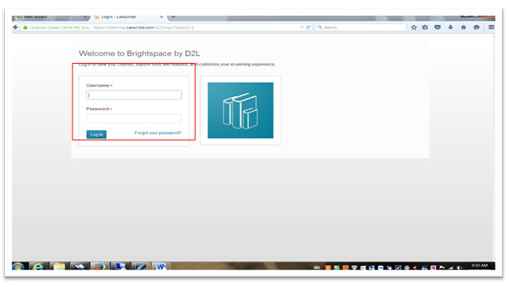
Logging on to the Program Online
Go to https://www.elearn.training/ which will bring you to the login screen seen below. Enter the username and password provided to you.

Slide 13
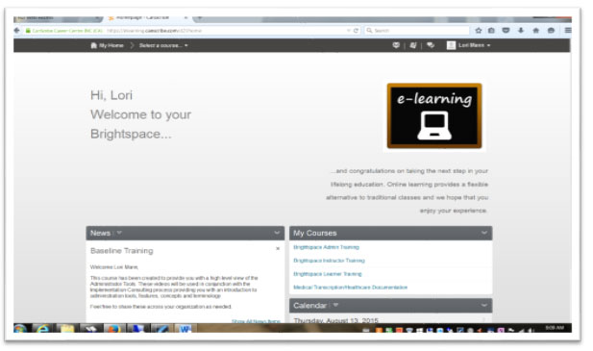
After signing in, you will be directed to your Homepage. From here you can access all program chapters, messages from the Facilitator, and Calendar events.

Slide 14
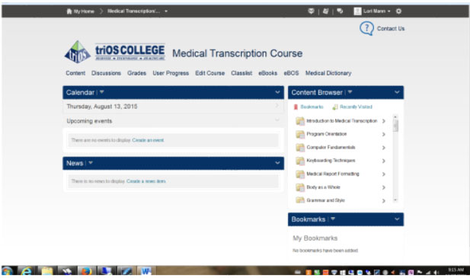
In the ‘Select a Program’ drop-down list at the top of the webpage, there are links to access the Brightspace Learner Training, which has step-by-step instructions and information on how to navigate the website. If you select ‘Medical Transcription Healthcare Documentation Program’, you will arrive at the screen seen below.

Slide 15
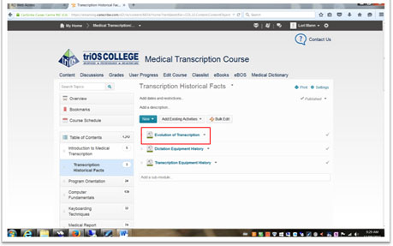
Starting the Program
Click on the first chapter, ‘Introduction to Medical Transcription’ under ‘Content Browser’ to begin the Medical Transcriptionist Program. On this page you will see an overview of the chapter, any bookmarks you save, the program schedule, and a Table of Contents.
To start the chapter, click the first link ‘Evolution of Transcription’.

Slide 16
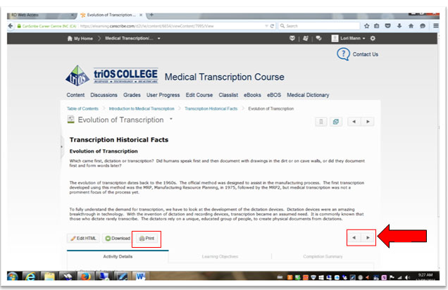
Use the left and right arrow keys to move forward (or back) a page. Explore the page and become familiar with the features of the site.
Note: Using the ‘Print’ option on any page will use up the Print Credits given to you when you began the program.

Slide 17
Additional Information
In addition to using your online resources, we have also provided you with a Medical Transcriptionist Resource Guide which includes a breakdown of all program chapters into a weekly schedule containing:
- chapter titles
- chapter length (in hours)
- topics covered in each chapter
Utilize this tool as your progress through the program, as this will help ensure you stay on target with your completion dates. Your Facilitator will also be monitoring your progress to ensure your target dates are being met, as well as to assist you with any concerns you may have.
Note: Each screen has a “Print” option in the bottom left hand corner. It is not recommended that you print any of the pages since your print credits (available to you as a triOS College student) will be quickly depleted and it will be very costly to you.

Slide 18
Internship
Your internship is eight (8) weeks in duration. Your campus Employment Specialist will organize your internship once they have been advised by the Facilitator that you have completed your program and have been approved to move forward into the internship portion of the program.
During your internship, you will either be on-site (at the campus) or off-site. You cannot split up your internship between these two options. Should your internship be on-site, you are required to be in the classroom for 4 hours per day, five days a week over the eight weeks of the internship.
Contact your Employment Specialist to discuss your internship options further.
If you are completing your internship on-site, you will be working closely on a daily basis with the Quality Assurance (QA) person. The QA will provide you with feedback on the reports that you type. You will be working on live reports – reports that real doctors are dictating on real patients.
The internship will provide you with the opportunity to hone the skills that you have acquired throughout your program.
The QA person will be completing an evaluation of your internship and you must receive a passing grade in order to graduate from the program.

Slide 19
Final Comments
You have started your journey with a vision and have chosen a path that will lead you to success. This will involve dedication, choices that will set goal patterns, and the ability to properly put in place a healthy balance of work and life. This will be a busy year for you, but a very rewarding one, as you have made the choice to further your education and achieve your career choice. Good luck, and I look forward to playing a part in helping you achieve your career goal!

